Slide 1
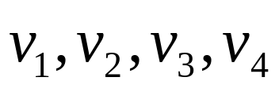
Graph
Graph: A set of nodes V
A set of edges E from V x V
V={ }
E={ }
v2
v1
v3
v4

Slide 2
Path
Graph G=(V,E)
A path is a series of edges linked one by one
Loop:

Slide 3
Tree
A graph is connected if every two nodes have a path to connect them
A tree is a connected graph without loop

Slide 4
Connected Graph→ Tree
Every connected graph can be converted into tree by removing some edges
Removing one edge on a loop does not damage the connectivity.

Slide 5

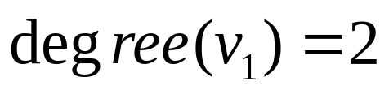


Node degree:
The number of edges connecting to the node
v2
v1
v3
v4

Slide 6
Problem
Consider the undirected graph G=(V,E) where V={1,2,3,4} and E={{1,2}, {2,3},{3,1},{2,4},{1,4}}. Draw the graph G, and indicate a path from node 3 to node 4 on G.

